Slide 1


Slide 2

Day 8: Agenda
Introduction to SVM (Support Vector Machine)
The Concept of Margin and Support Vectors
Kernel Trick for Non-Linear Data
Introduction to K-Nearest Neighbors (KNN)
How KNN Makes Predictions Based on Nearest Neighbors
Distance Metrics: Euclidean, Manhattan, and Others
Choosing the Value of K
Hands-On Practical Example: Classification and Regression

Slide 3
Support Vector Machine (SVM)
SVM is a machine learning algorithm used for classification and regression.
It aims to find an optimal hyperplane to separate data into distinct classes or make regression predictions.
It's effective in high-dimensional spaces, handles non-linearity through kernel functions, and is less prone to overfitting.
Classification:
SVM separates data effectively, even in high dimensions.
It's robust against overfitting.
The kernel trick allows it to handle non-linear data.
Regression:
SVM can be used for regression by minimizing ε-insensitive loss.
It's robust and can capture non-linear relationships using kernel functions.

Slide 4
Margin in SVM
Definition: The margin in Support Vector Machine (SVM) is the gap between the decision boundary (hyperplane) and the nearest data points from different classes.
Significance:
A larger margin indicates a more confident and robust classification.
It allows better generalization to unseen data.
Support Vectors:
Support vectors are the data points closest to the decision boundary.
They influence the position of the hyperplane and the margin.

Slide 5
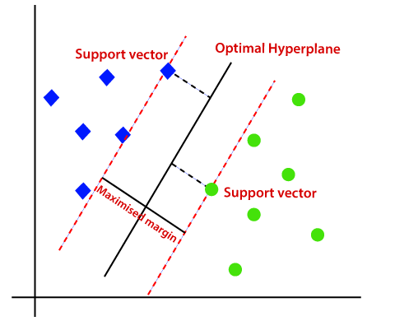
Margin in SVM

Slide 6
Hands-on: SVM Classified
Write a code for an ML model that incorporates an SVM classifier on the Breast Cancer dataset. Visualize the result using PCA.
Notes:
Note:- Use Jupyter file for this question - SVM classifier - Breast Cancer Dataset (In-built).ipynb

Slide 7
Handling Non-Linear Data
Non-linear data refers to data with intricate, non-linear relationships between features and classes.
The kernel trick is a technique to address non-linearity, often used with SVM, transforming data into higher-dimensional spaces.
Linear classifiers, like SVM, struggle with non-linear data.
The kernel trick avoids the need to explicitly map data to higher dimensions, saving computational resources.
This technique enhances SVM's versatility by allowing it to establish non-linear decision boundaries for complex data distributions in classification tasks.

Slide 8
Kernel Function
Kernel functions are mathematical functions used in SVM to transform input data into a higher-dimensional feature space.
Linear kernels simply compute the dot product between data points in the input space.
Polynomial kernels capture polynomial relationships, allowing SVM to model curved decision boundaries.
Radial basis function (RBF) kernels create flexible, non-linear decision boundaries, suitable for complex data distributions.
Kernels enable SVM to work effectively in high-dimensional spaces, simplifying classification by projecting data into spaces where classes are more separable.

Slide 9
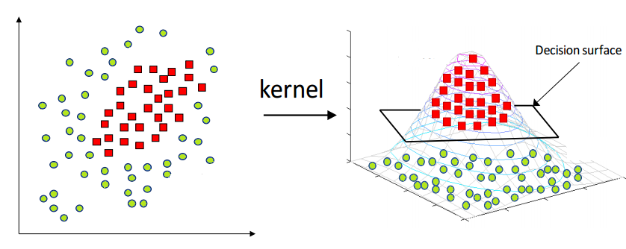
Kernel Trick

Slide 10
K-Nearest Neighbors (KNN)
K-Nearest Neighbors (KNN) is a versatile supervised learning algorithm for both classification and regression tasks. It operates based on the following principles:
Classification:
Assigns a data point to a class by considering the majority class among its k-nearest neighbors, where "k" is a user-defined parameter.
Assumes that similar data points in feature space belong to the same class.
KNN's simplicity makes it an excellent choice for certain classification problems.

Slide 11
K-Nearest Neighbors (KNN)
Regression:
Predicts a data point's value by averaging the target values of its k-nearest neighbors.
Suitable for making predictions involving continuous or numeric outcomes.
Like in classification, the choice of "k" significantly influences the model's predictive performance.
In both cases, selecting an appropriate "k" value and distance metric is crucial for achieving accurate results.

Slide 12
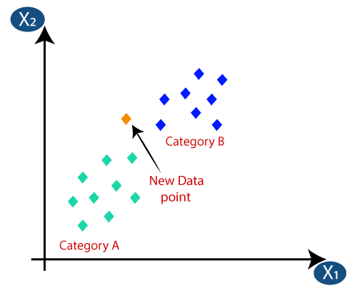
K-Nearest Neighbors (KNN)

Slide 13
KNN Algorithm Steps
Select the Number of Neighbors (k): Choose the value of k, the number of nearest neighbors to consider.
Calculate Distances: Compute the distance between the data point to classify and all other data points.
Identify Nearest Neighbors: Choose the k data points with the shortest distances as the nearest neighbors.
Majority Voting (Classification): In classification, predict the class based on the majority class of the nearest neighbors.
Average (Regression): In regression, predict the target value by averaging the values of the nearest neighbors.

Slide 14
Role of Nearest Neighbors
Influence Predictions: Nearest neighbors impact a data point's prediction.
Local Insights: They reveal nearby data characteristics.
Weighted Voting: Proximity-based weighting may apply.
K Value Matters: Choice of k influences prediction sensitivity.

Slide 15
Distance Metrics
Measure Similarity: Quantify the dissimilarity between data points.r
Euclidean Distance: Straight-line distance in space.
Manhattan Distance: Sum of absolute differences.
Minkowski Distance: Generalized metric based on parameter p.
Distance metrics gauge data similarity and are essential for clustering and classification algorithms.

Slide 16
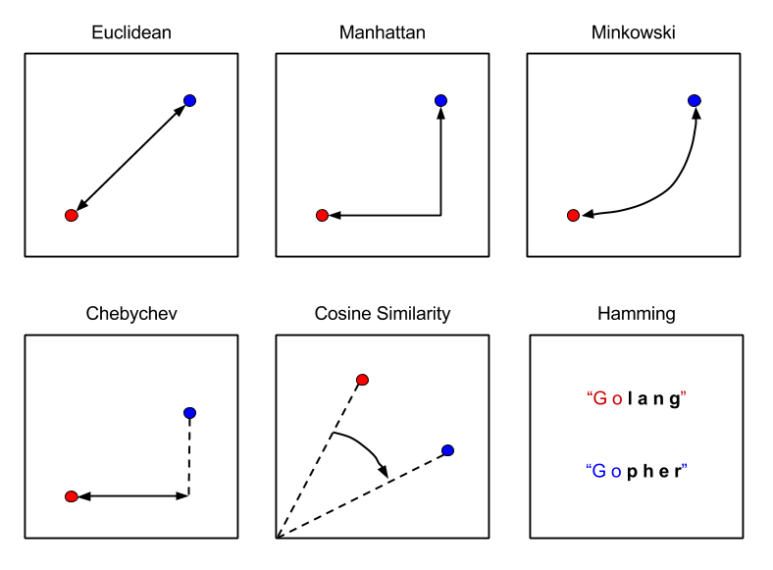
Distance Metrics

Slide 17
Selecting the Value of K
The number of nearest neighbors (K) is crucial.
Small K:
Low bias, high variance.
Prone to overfitting.
Large K:
High bias, low variance.
Smoother but may underfit.
Optimal K: Found through cross-validation.
Impact: K affects bias and variance.
Trade-offs: Balance is needed for a well-generalized model.

Slide 18
Hands-on: KNN Classifier
Implement the K-Nearest Neighbors (KNN) algorithm for classification using the Iris dataset, along with visualizing and interpreting the results. Choose the value of K.
Notes:
Note:- Use Jupyter file for this question - KNN Classifier - Iris Dataset.ipynb

Slide 19
Questions ?

Slide 20
Thank You !

